Slide 1
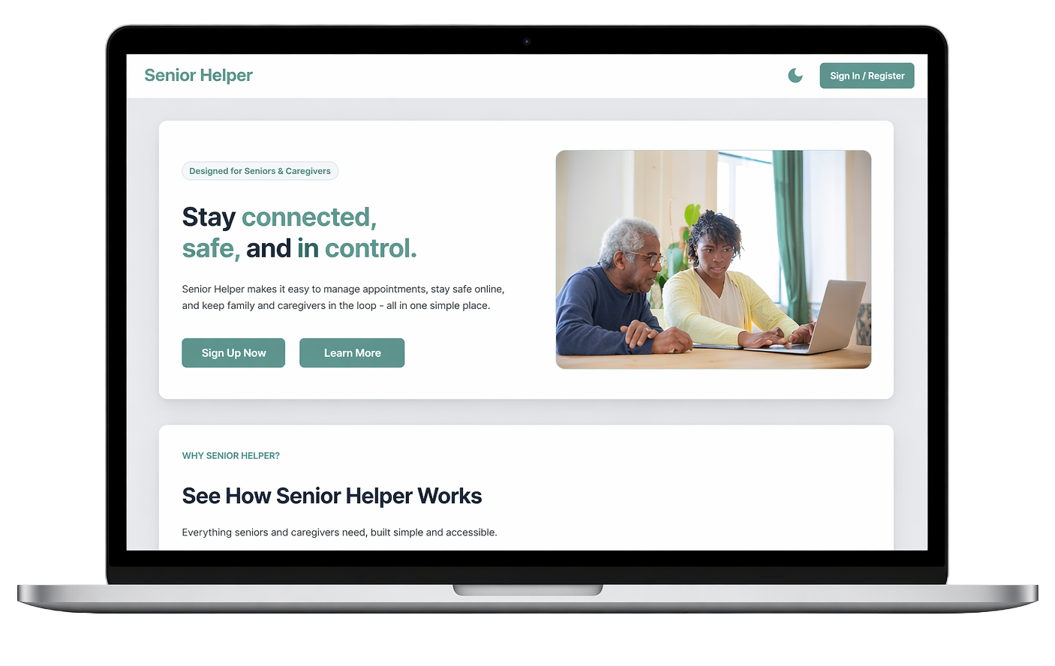
Senior Helper
Frontend-Focused Development Presentation
A modern, intuitive platform that helps seniors and caregivers stay connected, safe, and in control.
CEN4025C Project Presentation – Spring 2026 Presented By: The Senior Helper Development Team
For Florida State College at Jacksonville
Notes:
We’re excited to present Senior Helper – a modern, accessible web application designed to help seniors stay connected, safe, and in control of their daily lives.
Throughout this presentation we’ll walk through the problem we set out to solve, the frontend architecture and components we built, and how everything comes together to serve both seniors and their caregivers.
We’ll also cover our integration with the backend, our testing approach, and wrap up with a live demo of Senior Helper.
But before any of that, let’s meet the team behind it.

Slide 2

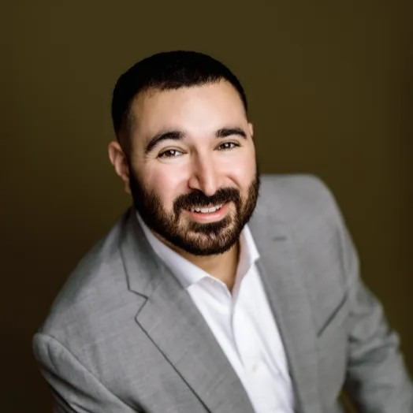


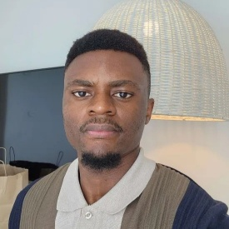
Our Senior Helper
Development Team
Lauren Knotts
Ricardo Serrano
Dewey Mccrary
Project Lead, Scribe, Full-Stack Developer
Full-Stack Developer
Scribe
Full-Stack Developer
Focus
Focus
Focus
Education System User Connections Landing Page
Authentication
Landing Page
Admin Permissions
Calendar Functionality
Calendar Notifications
Dayne
Allen-Wright
Tamia Jenkins
Baudelaire Messago Ngumouo
Full-Stack Developer
Full-Stack Developer
Full-Stack Developer
Focus
Focus
Focus
Calendar Functionality
User FAQ
User Connections
User FAQ
User Connections
User Feedback
Notes:
Our team consists of six members, each owning specific features across the full stack.
I'm Lauren — project lead and scribe, and on the development side I focused on the education system, user connections, and the landing page.
Ricky also served as scribe alongside his development work, focusing on authentication, the landing page, and admin permissions on the backend.
Dewey owned the calendar functionality and built out the notification reminder system that keeps seniors on top of their upcoming appointments.
Dayne also worked on calendar functionality and developed the FAQ section of the application.
Tamia focused on user connections and contributed to the FAQ as well.
And Baudelaire rounded out the team with work on user connections and the user feedback and review system.
Together we designed, built, and tested the Senior Helper application across both the Angular frontend and Spring Boot backend.

Slide 3
Project Overview & Frontend Objectives
Overview
Objectives
Angular-based frontend serving three main user roles: Senior, Caregiver, and Admin
Appointment calendar with notification reminders for upcoming events
Online safety education through scam-awareness lessons and quizzes
Caregiver linking system giving family members visibility into a senior’s schedule
Accessible design with dark mode, large text, and simple navigation
Build an intuitive, accessible Angular frontend framework for seniors with minimal tech experience
Implement responsive UI components for appointments, modules, lessons, quizzes, and caregiver connections
Integrate securely with the Spring Boot REST API using token-based authentication
Deliver end-to-end tested user flows with Cypress
Notes:
Senior Helper is an Angular frontend that connects to a Spring Boot backend through a REST API. Once logged in, the app serves two distinct user types — seniors and caregivers — each seeing an experience tailored to their needs.
The application is built around three core features.
The appointment calendar keeps seniors organized with notification reminders for upcoming events.
The education section guides seniors through scam-awareness lessons and quizzes at their own pace.
And the caregiver linking system gives family members direct, real-time visibility into a senior's schedule — no phone calls needed.
Accessibility wasn't an afterthought — it was a design requirement from day one. Dark mode, clean navigation, and readable layouts were built in throughout to make sure the app works for users who may be new or cautious to technology.
Those priorities shaped our four frontend objectives.
Building an Angular framework approachable enough for seniors with no tech background.
Delivering responsive components across every feature of the app.
Integrating securely with the backend so every request is properly authenticated.
And validating our most critical user flows — login and appointment management — through Cypress end-to-end tests.

Slide 4
Project Vision: Problem & Solution
The Problem
Our Solution
Seniors are among the fastest-growing demographics targeted by online scams
Existing tools like Google Calendar weren’t built for seniors who may be using a computer or smartphone for the first time
Caregivers and family members are often left out of the loop, relying on phone calls to stay updated on a senior’s schedule
No single platform combines organization, safety, and caregiver access in one place
A clean, accessible frontend designed from the group up with seniors as the primary user
Integrated appointment calendar with customizable reminders, shared with caregivers
Dedicated scam-awareness lessons and quizzes built into the application
Role-based navigation tailored for Seniors and Caregivers
Notes:
So, let's talk about why Senior Helper exists. The problem really comes down to three groups of people being underserved at the same time.
First, seniors. Older adults are now one of the fastest-growing targets for online scams — phishing emails, fake tech support calls, fraudulent websites. And the cruel irony is that the resources meant to help them are just as hard to navigate as the threats themselves. On top of that, the everyday tools we take for granted — Google Calendar, reminder apps, even email — were never designed for someone who might be picking up a smartphone for the very first time. The learning curve is steep, and most seniors just give up if it’s too complex.
Second, caregivers. Right now, staying informed about a senior's schedule means phone calls, text messages, or physically being there. There's no shared system, no real-time visibility. A caregiver has no way of knowing if an appointment was missed or if something changed unless the senior tells them directly — and that's not always reliable.
And third — nobody has put all of this together in one place. There are calendar apps, scam awareness websites, family coordination tools — but they're all separate, they all require separate logins, and none of them were built with seniors in mind.
That's exactly what our solution addresses. Senior Helper is a frontend we built from the ground up with seniors as the primary user — not an afterthought. Every design decision prioritized simplicity and accessibility. The appointment calendar connects directly to caregivers through our linking system so everyone stays in sync automatically. The education section brings scam awareness lessons and quizzes right into the app in a format that's easy to follow. And because we have two distinct user types, seniors and caregivers each get a tailored experience — seniors see their own dashboard, appointments, and education modules, while caregivers see the schedules of the seniors they're linked to.

Slide 5


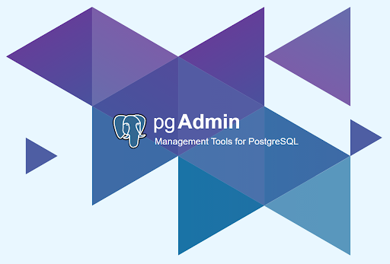
Tools & Processes
Visual Studio Code (Frontend)
JetBrains IntelliJ (Backend)
PgAdmin4 (Database)
Notes:
Integrated Development Environments (IDEs):
IntelliJ IDEA: Primary tool for Java/Maven backend development (robust refactoring and profiling).
VS Code: Preferred for Angular frontend development and Cypress test scripting due to its lightweight nature and TypeScript support.
PgAdmin4: The preferred means of manual CRUD operations when you wanted to verify changes were being writing to the PostgreSQL database.

Slide 6


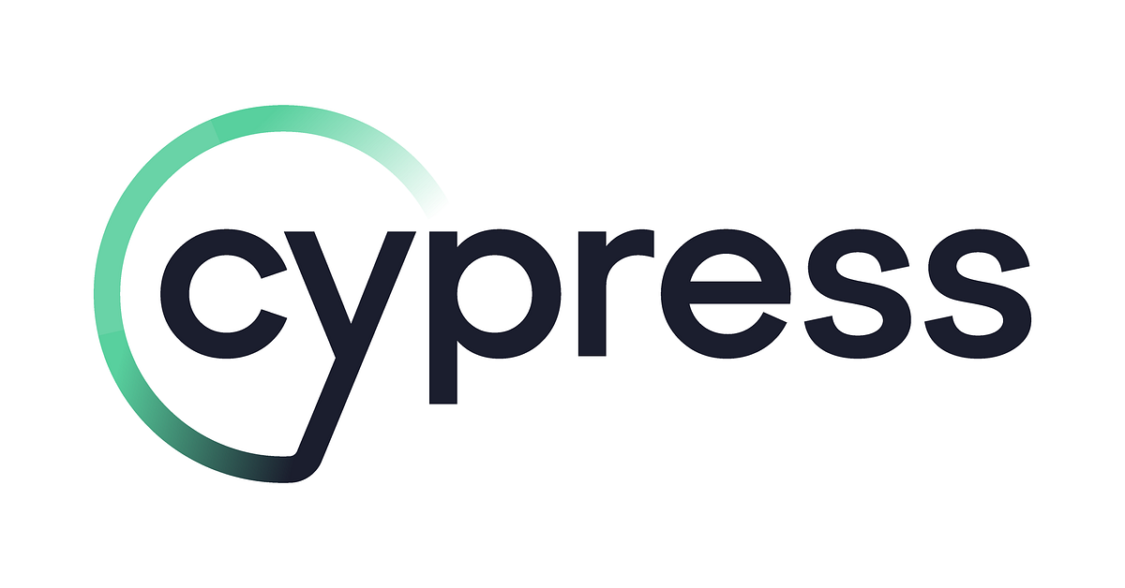
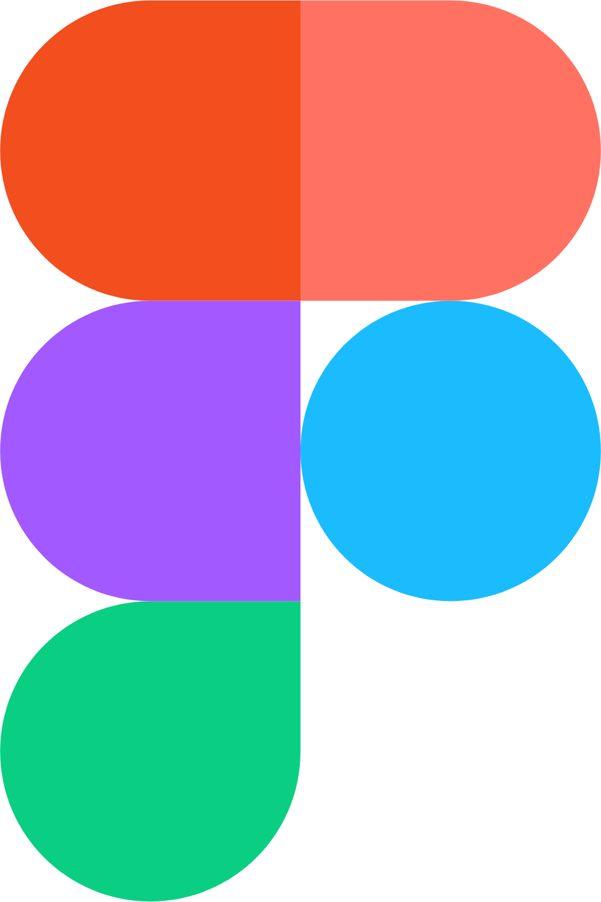
Tools & Processes
(Frameworks)
Angular (Frontend Development)
Maven (Backend Development)
Cypress (Testing and QA)
Figma (UI and UX Design)
Notes:
Core Frameworks:
Frontend: Angular for building a reactive, component-based UI.
Backend: Java with Maven for dependency management and build automation.
Testing: Cypress for end-to-end (E2E) testing to ensure seamless user flows.

Slide 7


Tools & Processes
(Agile Workflow)
Sprint Planning
Every Wednesday, team meets were held on Webex
Sprint Review
End-of-Week meeting held on Discord to ensure all weekly goals were met
Notes:
Sprint Planning: Every Monday to define the backlog and assign Story Points to tasks.
Sprint Review & Retrospective: End-of-week sessions to demo features and refine team processes.

Slide 8
Tools & Processes
(CI / CD / QA Pipeline)
Behavior Testing
Isolation: Decoupling the frontend and backend
Validation: Verifying proper Angular state changes
Notes:
"Our Cypress Strategy: Behavioral Testing"
Isolation: We use cy.intercept to decouple the frontend from the backend during UI tests, allowing us to test edge cases (like server errors) easily.
Validation: We verify that the Angular state changes (URL redirection) only after a successful 200 response from the Java API.
Resilience: By using data-cy selectors, our test suite remains robust even if the UI undergoes a visual redesign.

Slide 9
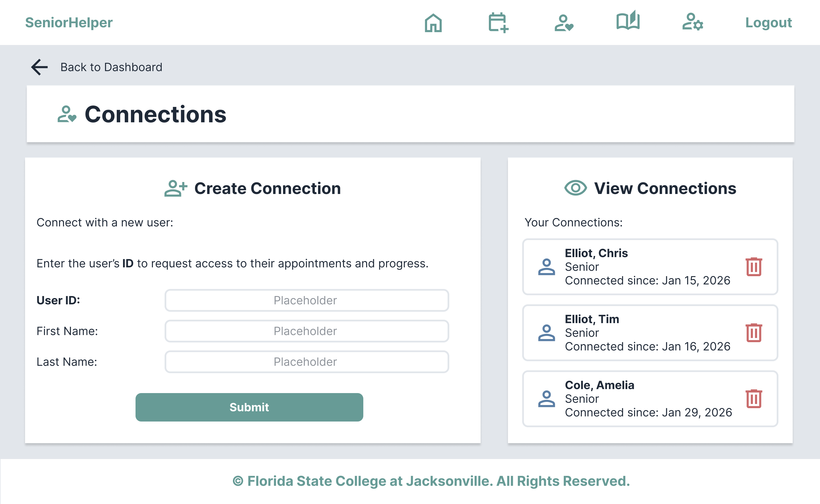
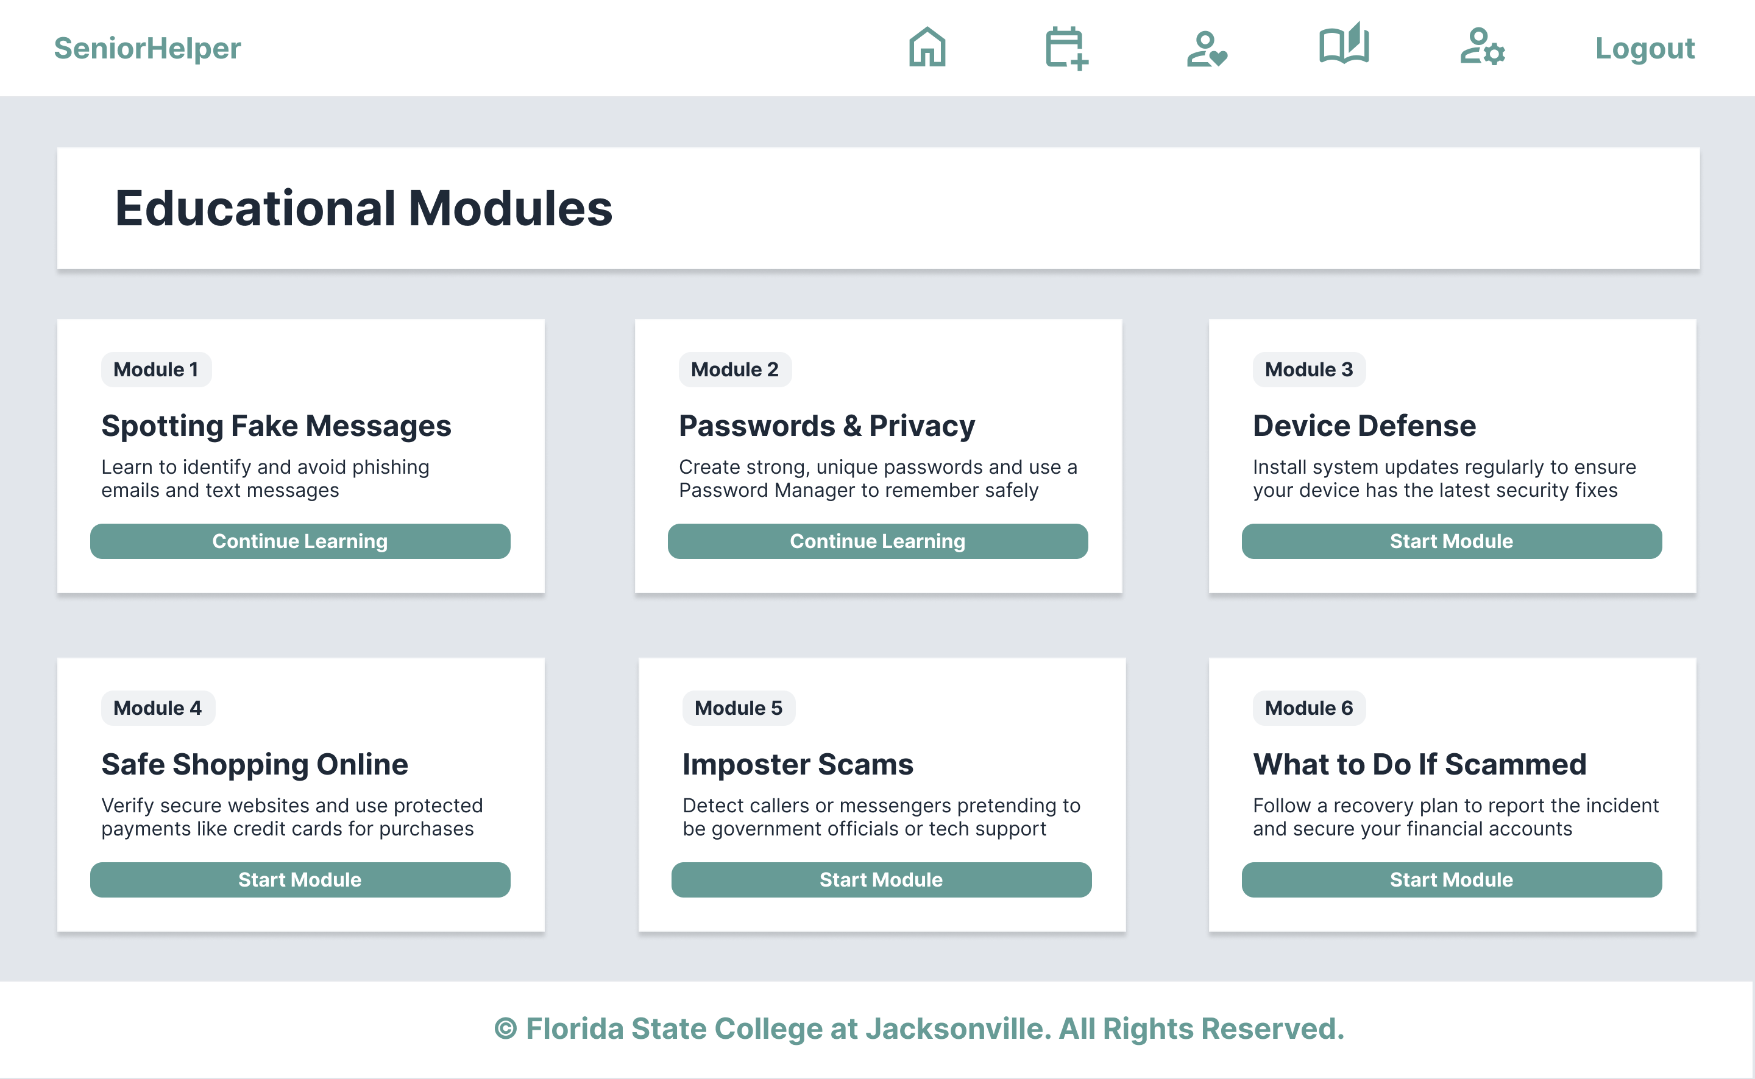
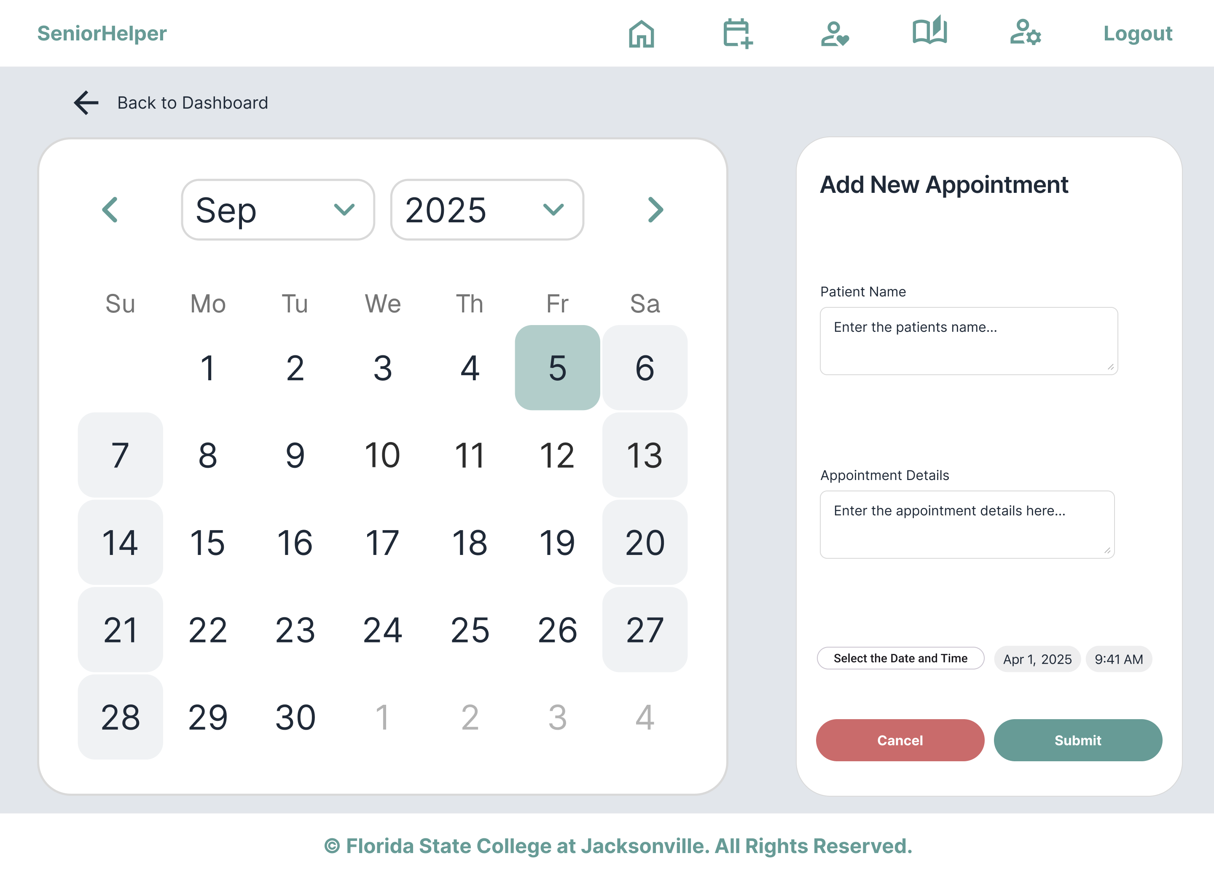
Design Steps
Started with 9 user stories, but as features expanded and user needs became clearer, we grew to 14 completed and 5 backlogged user stories by the end of the project
Shifted from functionality-based groups to feature-owned assignments for better accountability
Wireframes and sketches guided every screen before development began, keeping the UI consistent across all 6 developers

Slide 10
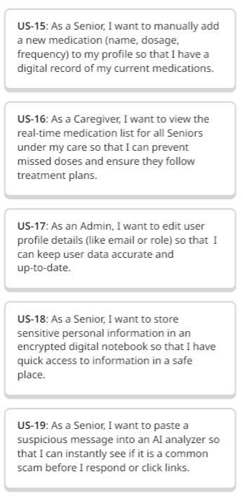
Backlogged Tasks & Features
Health & Care Coordination
Enable Seniors to log medications and provide Caregivers with real-time visibility into their medication adherence.
Security & Scam Prevention
Introduce an AI-driven Scam Tracker to help Seniors identify and avoid fraudulent messages.
Refined User Management
Equip Admins with tools to edit and update user profile details to ensure platform data remains accurate and current.

Slide 11
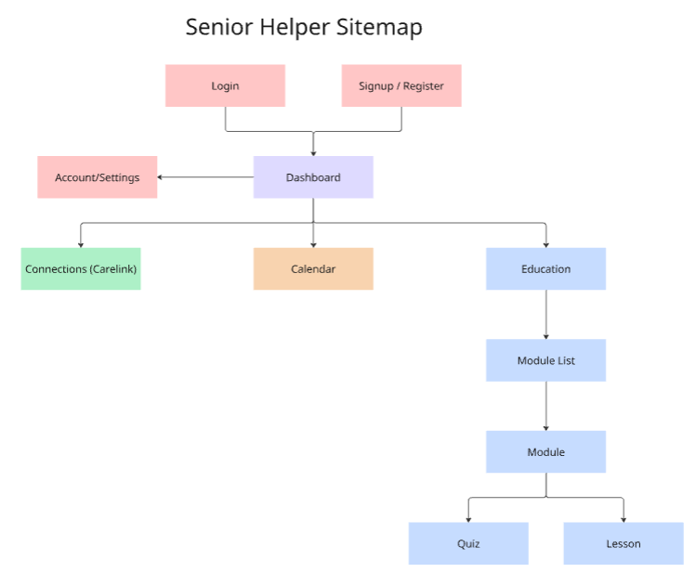
Architecture & Main Components
Information Architecture
& User Navigation
Designed a streamlined architecture to minimize cognitive load, ensuring the interface is accessible and easy for Seniors to navigate.
Core features are prioritized within a Global Navigation Bar and a Central Dashboard, providing one-click access to essential tools.
Implemented a high-level Landing Page to establish brand trust and provide clear value propositions before the authentication process.
Notes:
Following the structures of many websites before us we designed an architecture that presented a simple UI to navigate The main features are directly accessible from the dashboard and a navigation bar
A landing page was added before the login/registration to provide a short description of the team and the app

Slide 12

Implementation
Worked in small teams using feature branches to isolate development
Kept the main branch stable
Merged changes through Pull Requests (PRs) only
Used code reviews to catch bugs and enforce consistent structure
Notes:
To manage development across multiple team members, we used a structured GitHub workflow. Everyone worked within smaller teams on their own feature branches, and the main branch was kept stable. All changes went through pull requests, where we reviewed each other’s code. That helped us catch bugs early and keep the codebase consistent.

Slide 13
Implementation Cont'd
Translated design mockups into Angular components
Built reusable components and shared styling
Implemented service layer and integrated with backend APIs
Notes:
We designed our UI in Figma, then converted those mockups into Angular components with a focus on simplicity and usability.
We reused components and centralized styling to keep the UI consistent and avoid duplicating code.
We integrated the frontend with the backend using a service layer to handle API calls, keeping the codebase organized and maintainable.

Slide 14
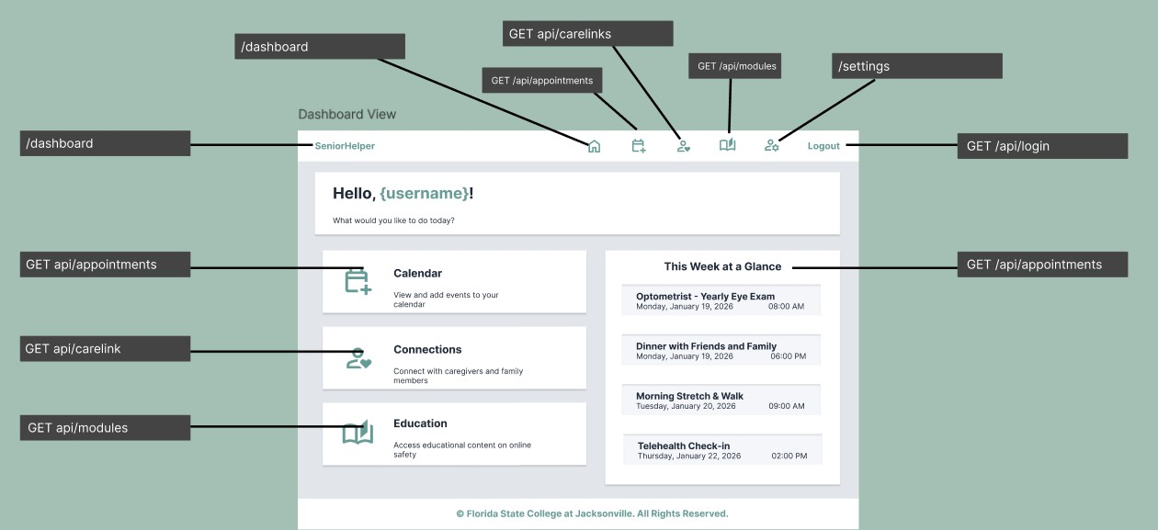
Implementation Cont'd

Slide 15
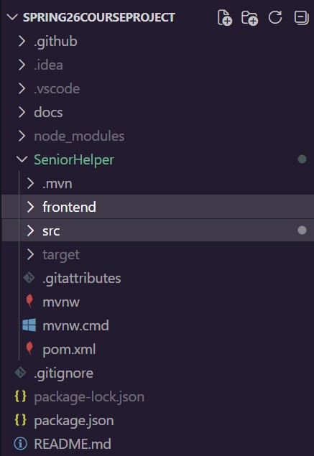
Implementation Cont'd
Configured routing for seamless navigation
Tested and refined UI to ensure usability and responsiveness
Packaged frontend into Spring Boot application for unified deployment
Notes:
We set up routing within the app to let users move between views without reloading the page, giving the app a smooth, fast feel.
We tested UI across different screen sizes and adjusted styling to make sure the app is usable on both desktop and smaller devices.
Finally, we took our fully built Angular frontend and bundled it into our Spring Boot project using Maven, so the entire application runs as a single deployable unit.

Slide 16
Live Demonstration!
Notes:
We set up routing within the app to let users move between views without reloading the page, giving the app a smooth, fast feel.
We tested UI across different screen sizes and adjusted styling to make sure the app is usable on both desktop and smaller devices.
Finally, we built the Angular app and bundles it into our Spring Boot project using Maven, so the entire application runs as a single deployable unit.

Slide 17
Security
Considerations
Route & Role Protection
Authentication guards prevent unauthorized users from accessing protected routes based on their role
Proper Error Handling
Standardized error responses ensure sensitive system information is never exposed to the client
Token-Based Authentication
Every API request requires a valid token, ensuring only authenticated users can retrieve or modify data
Caregiver Access Control
Caregivers can only view data for seniors they are explicitly linked to – no cross-account access
Notes:
Making sure roles are only allowed to access what they should be under their account
Corrected error codes

Slide 18
Security
Design Reviews
HTTP Interceptors
Automatically attach the user's auth token to every outgoing API request without requiring manual handling in each component
Route Guards
Block unauthenticated users from accessing protected pages and redirect them to login if no valid session token is found

Slide 19
Implemented Security Features
Cypress End-to-End (E2E) Tests
Automated tests validate that protected routes behave correctly for authenticated users
Role Authentication
Users are assigned a role on registration that determines what data and pages they can access
HTTP Interceptors & Route Guards
Authentication tokens are automatically attached to every outgoing request and unauthenticated users are blocked from protected pages
Notes:
Cypress E2E Tests
Role Authentication
Added security layers for routing and HTTP requests

Slide 20
Security Features
Needed / Planned
Email Verification
Confirm a user’s email is valid before granting account access
Account Recovery
Allow users to securely reset their password if locked out from Sign In page
Multi-Factor Authentication (MFA)
Require a second form of verification at login for added protection
Notes:
Distinctive features we could have looked into:
Email verification during account registration
Account recovery
Multi-Factor Authentication (MFA)

Slide 21
Team Challenges
Team Reconstruction
Scheduling
Lost a team member from the first term but brought on a new developer for Spring
Incoming team member had to onboard mid-project, getting up to speed on existing code and conventions
Responsibilities were redistributed to ensure no features were left without an owner
Team members had varying availability across work, school, and personal commitments
Scheduling conflicts caused some tasks to fall behind, requiring other members to step in and take over components
Uneven workload distribution at times meant some developers had to switch between their own features and others during sprints

Slide 22
Project Challenges
Learning New Tools
System Integration
Frontend Logic
Working with Angular, VSCode, and Cypress for the first time
Team members collaborated and shared knowledge to get up to speed together
Connecting the Angular frontend to the Spring Boot backend via REST API
Handling CORS configuration and ensuring authentication tokens were correctly passed with every request
Managing complex component states and how data flows across the UI
Structuring shared components and services to work seamlessly across multiple features

Slide 23
Future Plans & Improvements
Scam-Detection System
Secure Digital Notebook
Medication Tracker
Expand the existing heuristic model with AI-powered analysis for more accurate scam detection
Allow seniors to submit suspicious messages for real-time evaluation
A private, encrypted space to store notes, passwords, and personal information
Accessible only to the senior, with optional caregiver visibility on a per-note basis
Daily medication reminders with customizable schedules to help seniors stay on track
Logging system so caregivers can verify medications were taken without micromanaging

Slide 24
Lessons Learned
Frontend & Backend Integration
The critical role frontend and backend integration plays in delivering a seamless user experience
Routing & Navigation
How routing and navigation structure directly impacts how intuitive an app feels to use - poor navigation sends users in circles
Project Structure & Communication
Clear feature ownership and consistent team communication are essential when 6 developers are building one application simultaneously
Version Control & Merge Conflicts
Working across a shared codebase requires discipline – we learned firsthand how quickly merge conflicts escalate without proper branching conventions

Slide 25
Q&A Do you have any questions for our team?

Slide 26
Thank You

